Slide 1
Michigan Imputation Server
Angela Andaleon

Slide 2
Michigan Imputation Server Background

Slide 3
Abstract
Genotype imputation is a key component of genetic association studies, where it increases power, facilitates meta-analysis, and aids interpretation of signals. Genotype imputation is computationally demanding and, with current tools, typically requires access to a high-performance computing cluster and to a reference panel of sequenced genomes. Here we describe improvements to imputation machinery that reduce computational requirements by more than an order of magnitude with no loss of accuracy in comparison to standard imputation tools. We also describe a new web-based service for imputation that facilitates access to new reference panels and greatly improves user experience and productivity.
Das et al. (2016)
Notes:
This is the abstract from the paper for the service. The Michigan Imputation Server, hosted by the University of Michigan, is an imputation service that takes from two days to two weeks (last year) to take a dataset and return it quality controlled, phased, and imputed.

Slide 4
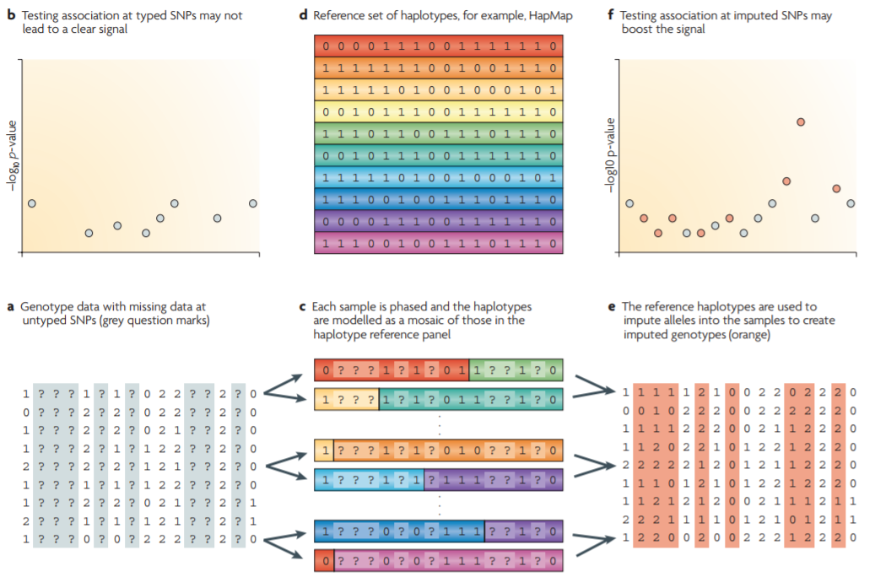
What is Imputation?
Marchini and Howie (2010)
Notes:
When genotypes are collected, they are incomplete, with the datasets I've used ranging from 300 thousand to 1.5 million SNPs. Imputation is the extrapolation of these missing genotypes into a given genotype set. For comparison, the Yoruba from Nigeria dataset I worked with had 12 million SNPs after imputation. By using the available collected genotypes after quality control, a fuller genome can be extrapolated using reference panels of appropriate populations.
This is seen in the above figure from Marchini and Howie (2010). (a) and (b) represent a collected genotype, which does not have strong associative signal on its own. In figures (c) and (d), the genotype is imputed by matching the most accurate reference set of haplotypes to the data. The results of this imputation is seen in figures (e) and (f), where the genotype is more through and receives a stronger associative signal that was not previously present in the original data.

Slide 5
Why Impute?
Boosts number of SNPs for testing
Increases power of testing
Fine-mapping of a causal SNP
Correction of genotyping errors
Marchini and Howie (2010)
Notes:
For example, in a cohort from Cebu, Philippines, that I ran, the most significant SNPs were actually those that were imputed, not in the original raw data.

Slide 6
What is the Michigan Imputation Server?
Minimac3 engine
“Increase computational efficiency with no loss of accuracy by leveraging local similarities between sequenced haplotypes.”
Eagle v2.3 (phased output)
“Estimates haplotype phase either within a genotyped cohort or using a phased reference panel.”
Das et al. (2016), Delaneau, et al. (2012)
Notes:
So, now that we have defined imputation and its benefits, how does the Michigan Imputation Server come into play? I’m not sure on the exactly technicalities of the computational methods used, but the paper by Das et al. (2016) describes the Server’s defining characteristics as using the Minimac3 engine for speed, and Eagle v2.3 for estimation of the proper phased reference panel.

Slide 7
Reference Panels
1000 Genomes Phase 3
2,504 samples from 26 global populations
Haplotype Reference Consortium
32,470 samples of predominantly European ancestry
African Genome Resources (Sanger)
4,956 samples from 1000G, Uganda, and various other African countries
Auton et al. (2015); McCarthy et al. (2016)
Notes:
Here are some sample, widely used reference panels in imputation. While the Haplotype reference consortium is the largest available reference panel, it is not appropriate for our data as it consists of majority European individuals. Another imputation service, the Sanger Imputation Panel, offers an African Genome Resources haplotype reference panel, which I used for our Yoruba from Nigeria dataset.

Slide 8
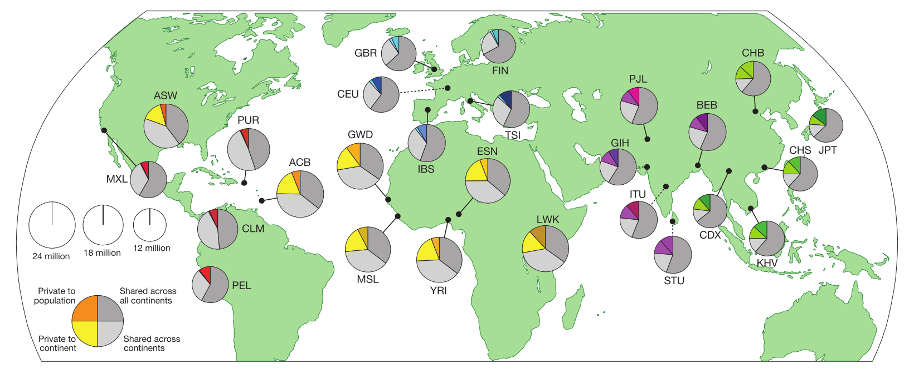
1000 Genomes Phase 3
Auton et al. (2015)
Notes:
1000 Genomes Phase 3 is currently the most thorough reference panel available for non-European populations for the Michigan imputation server. It contains genomes from 2,504 individuals from 26 global populations, depicted here. It totals almost 50m SNP sites for the first 22 chromosomes.

Slide 9
How to use the Michigan Imputation Server

Slide 10
Quality control
440,792 SNPs
1,799 individuals
Filter out SNPs w/ call rate < 99%
379,196 SNPs
1,799 individuals
Filter out SNPs w/ failed HWE (P < 1e-06) or lift over
369,185 SNPS
1,799 individuals
Remove individuals w/ +/- 3 SD for heterozygosity and failed sex check
369,185 SNPs
1,765 individuals
Notes:
I performed initial quality control in PLINK, including filtering out SNPs w/ call rate < 99%, and failed Hardy Weinberg Equilibrium. I also removed individuals who had over 3 standard deviations away for heterozygosity and failed a sex check. This left us with 369,185 SNPs and 1,765 individuals for imputation.

Slide 11
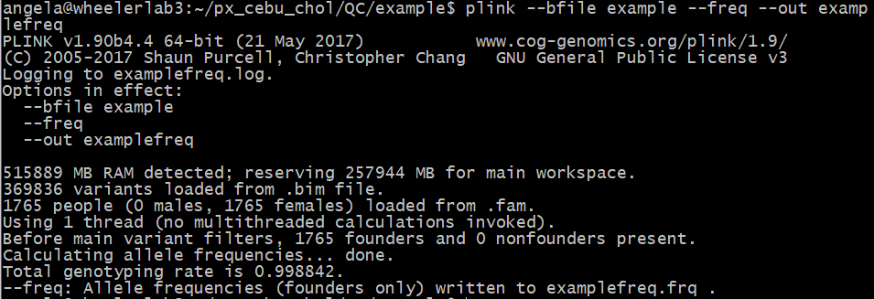
Create a .frq file
Notes:
So the second step after quality control is to create a frequency file, which contains, for each SNP, the chromosome code, the variant identifier, A1 and A2 alleles, the A1 frequency, and the number of allele observations. This will be used in a later software to prepared the data for imputaiton.

Slide 12

Run imputation Preparation and Checking (Command)
-b: bim file
Lists SNP ids, locations, major, and minor alleles
-f: frequency file
Lists SNP ids, locations, minor allele frequency, major, and minor alleles
-r: reference panel
-g: 1000 Genomes
-p: population
http://www.well.ox.ac.uk/~wrayner/tools/
Notes:
I then downloaded the Imputation preparation and checking tool, as well as the 1000G legend file, from the website listed in the corner, and ran this command. This included identifying the .bim file, the .frq files, specifying a reference legend, indicating the use of 1000 Genomes, and specifying a 1000G population. Here I used East Asian as it was most relevant to my cohort’s origin.

Slide 13
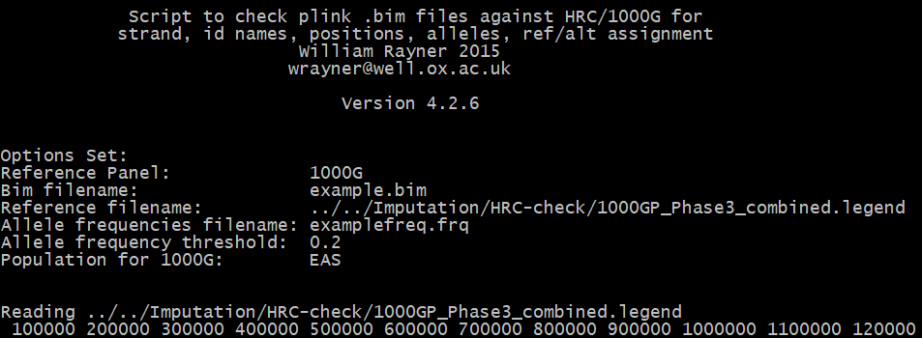
Run imputation Preparation and Checking (running)
Notes:
The script then runs, producing this at the beginning while the numbers on the bottom continue far into the millions.

Slide 14
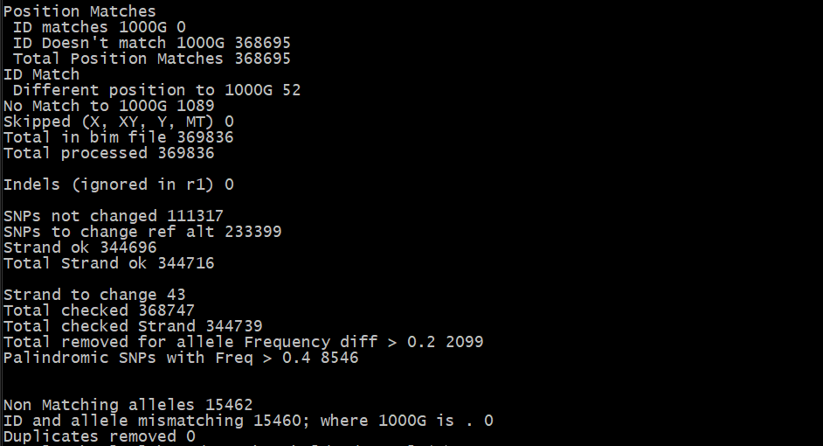
Run imputation Preparation and Checking (OUTPUT)
Notes:
The tool finally prints out this at the end, summarizing the changes made to the data, such as the 233,399 SNPs changed to the reference legend.

Slide 15
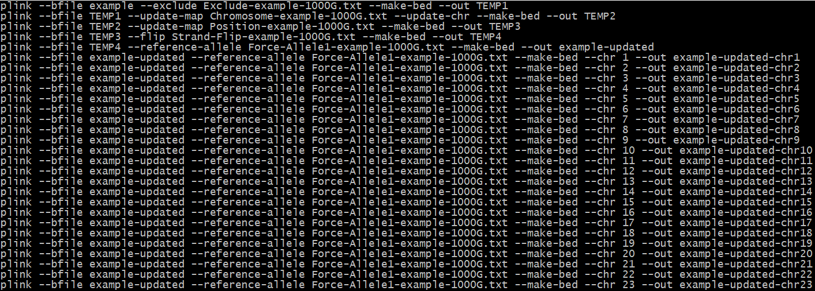
Run the “Run-Plink.sh” file the tool produced
Notes:
The tool then produced this bash script, which updates the chromosomes, positions, reference alleles, and flips them if necessary. This process is done for all the chromosomes.

Slide 16
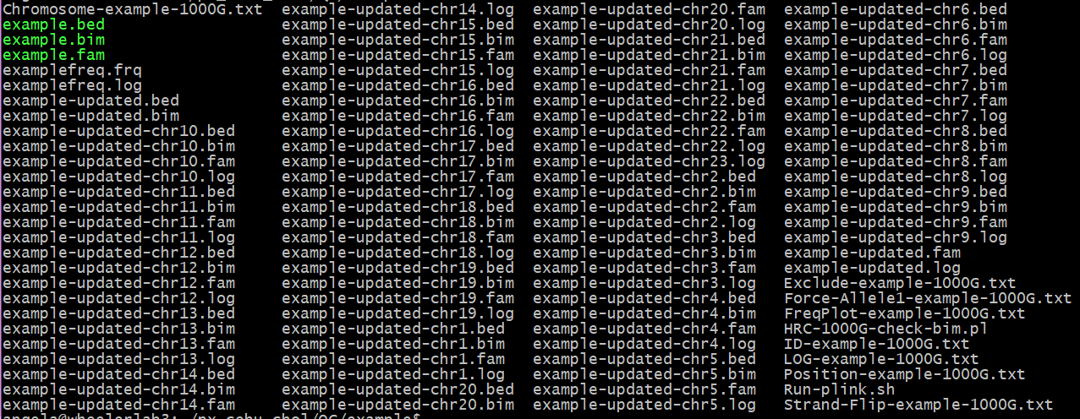
RUN-PLINK.SH Output
Notes:
The bash script then produced these .bed/.bim./.fam files with the corrected information, separated by chromosomes.

Slide 17
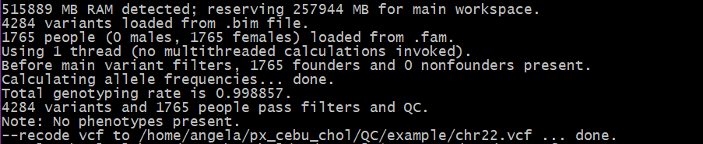
Convert Chromosomes to VCF
Notes:
With these updated chromosomes, I converted them from .bed/.bim/.fam to .vcf using PLINK, as described in the next slide.

Slide 18
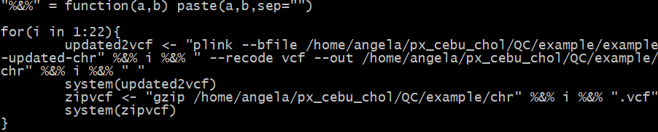
ZIP VCF files to vcf.gz
Notes:
To convert all the chromosomes and zip them at once, I wrote an R loop (because R is the only thing I’m sure in using) that converted then zipped the .vcf files

Slide 19
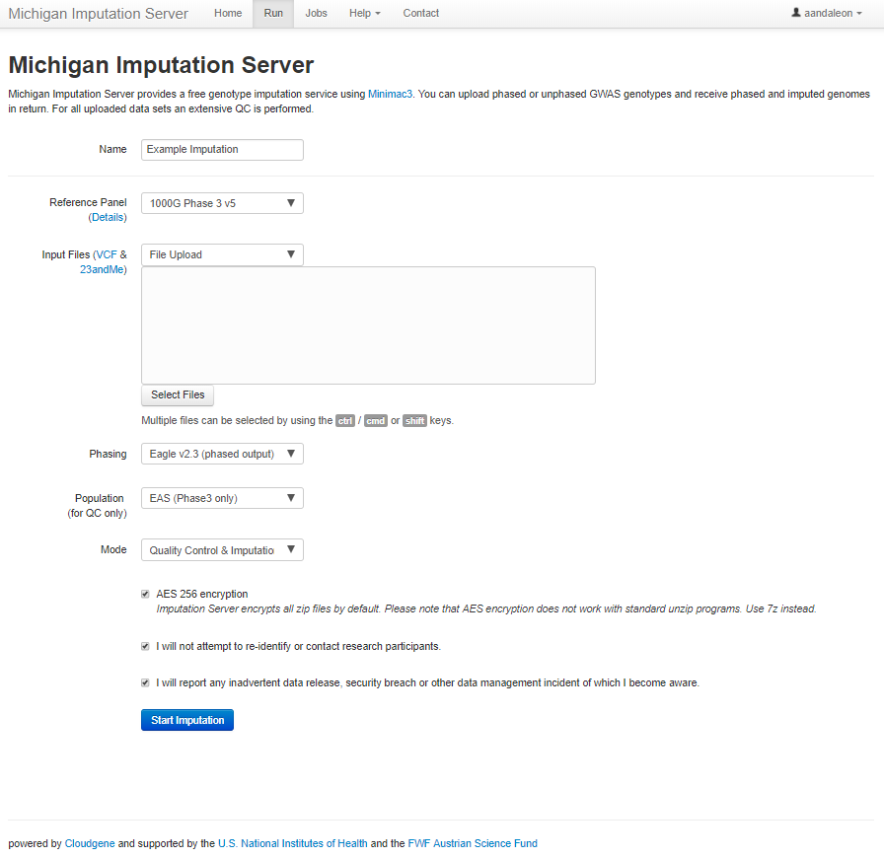
Choose Reference Panel, Phasing, and Population
Notes:
With the data properly formatted, we log in to the Michigan Imputation Server’s website and hit the run tab. In here, we choose the proper reference panel, phasing, and population for our data. In this example, I chose 1000 Genomes Phase 3 for a reference panel, Eagle v2.3 phasing, and East Asian population.

Slide 20
Upload VCF.GZ files
Notes:
After choosing our preferences, we manually go on the computer hosting the information and upload the data directly from there, since I don’t know how to make it work with SSH.

Slide 21


Slide 22
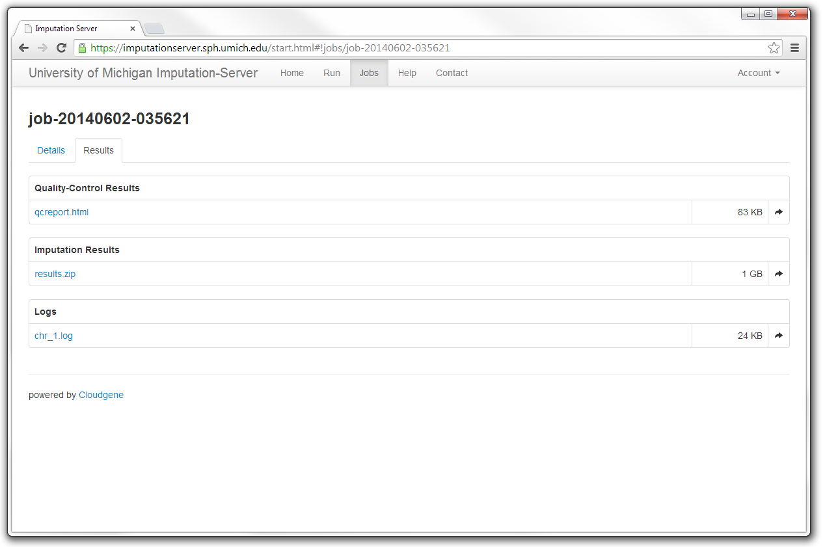
Download Imputed Data
Picture taken from the Michigan Imputation Server website
Notes:
The results page after the imputation looks similar to this, and you download each chromosome from under the title of Imputation results.

Slide 23
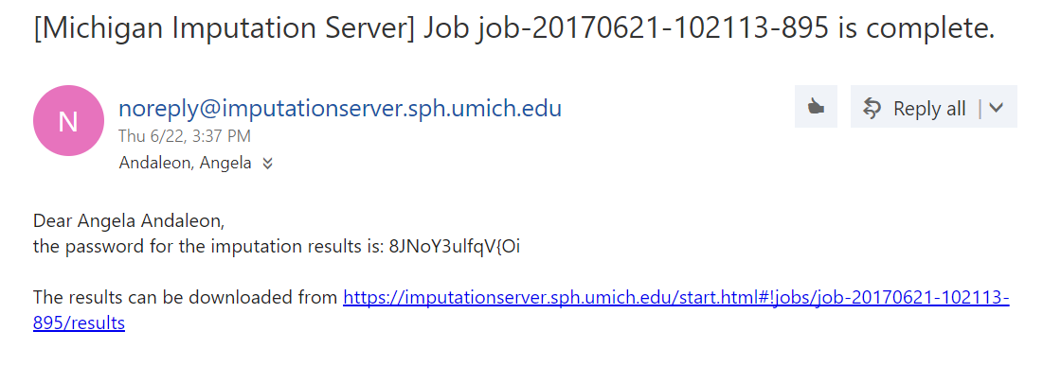
Unzip data using an Emailed Password
Notes:
After the data has been download, it has to be unzipped with a password sent from the imputation website.

Slide 24
References
Auton, A., Abecasis, G. R., Altshuler, D. M., Durbin, R. M., Abecasis, G. R., Bentley, D. R., … Abecasis, G. R. (2015). A global reference for human genetic variation. Nature, 526(7571), 68–74. https://doi.org/10.1038/nature15393
Das, S., Forer, L., Schönherr, S., Sidore, C., Locke, A., Kwong, A., … Fuchsberger, C. (2016). Next-generation genotype imputation service and methods. Nature Genetics, 48(10), 1284–1287. https://doi.org/10.1038/ng.3656
Delaneau, O., Marchini, J., & Zagury, J.-F. (2012). A linear complexity phasing method for thousands of genomes. Nature Methods, 9(2), 179–181. Retrieved from http://dx.doi.org/10.1038/nmeth.1785
Marchini, J., & Howie, B. (2010). Genotype imputation for genome-wide association studies. Nature Reviews Genetics, 11(7), 499–511. https://doi.org/10.1038/nrg2796
McCarthy, S., Das, S., Kretzschmar, W., Delaneau, O., Wood, A. R., Teumer, A., … Haplotype Reference Consortium. (2016). A reference panel of 64,976 haplotypes for genotype imputation. Nature Genetics, 48(10). https://doi.org/10.1038/ng.3643

